Slide 1
INTRODUCTION TO MULTIMEDIA
Mr. Butler
Digital Design

Slide 2
WHAT IS MULTIMEDIA?
In a generic sense, multimedia is simply the use of more than one media element. Hence, Web-based multimedia is defined as an online, interactive experience that incorporates two or more media elements including text, graphics, sound, animation and video. A fundamental feature of most Web-based multimedia is interactivity, which gives user some control over the content

Slide 3
WHAT IS MULTIMEDIA?
Multimedia – using more than one media:
Text
Graphics
Animation
Sound
Video

Slide 4
Multimedia Application Definition
A Multimedia Application is an application which uses a collection of multiple media sources e.g. text, graphics, images,sound/audio, animation and/or video.

Slide 5
DIGITIZED MULTIMEDIA
Today, this integration is accomplished by digitizing different media elements and then manipulating them with computer software
Digitized – Media elements have been captured in a code that the computer can understand

Slide 6
Multimedia Applications
Examples of Multimedia Applications include:
World Wide Web
Multimedia Authoring, e.g. Adobe/Macromedia Director
Hypermedia courseware
Video

Slide 7
Multimedia Applications
Interactive TV
Computer Games
Virtual reality
Digital video editing and production systems
Multimedia Database systems

Slide 8
What is HyperText and HyperMedia?
Hypertext is a text which contains links to other texts.
The term was invented by Ted Nelson around 1965.

Slide 9


Slide 10
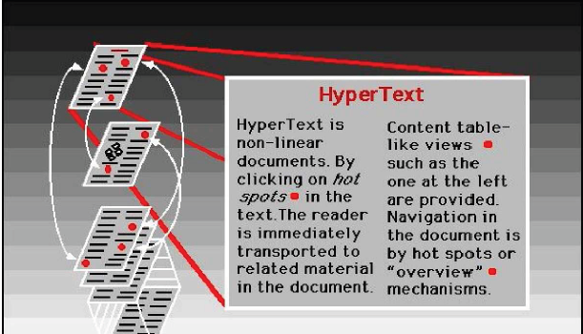
What is HyperText and HyperMedia?

Slide 11
What is HyperText and HyperMedia?
HyperText Navigation
Traversal through pages of hypertext is therefore usually
non-linear (as explained later).

Slide 12
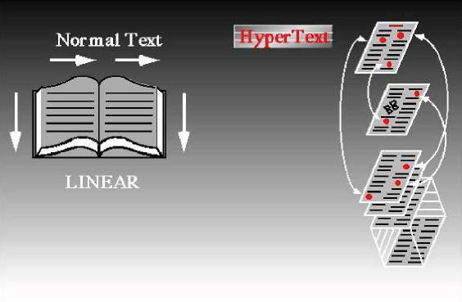
What is HyperText and HyperMedia?

Slide 13
Hypermedia
HyperMedia is not constrained to be text-based. It can include other media, e.g., graphics, images, and especially the continuous media – sound and video.

Slide 14
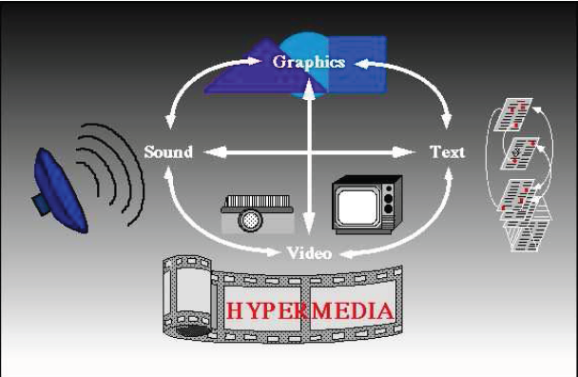
Hypermedia

Slide 15
Example Hypermedia Applications?
The World Wide Web (WWW) is the best example of a hypermedia application.
Powerpoint
Adobe Acrobat (or other PDF software)
Adobe Flash
Many Others?

Slide 16
LINEAR AND NONLINEAR MULTIMEDIA
A multimedia website can be linear, which users start at the beginning and progress through a set sequence of events until they reach the end. But most websites use a nonlinear approach to navigation, which users have more control over what they are interested in pursuing.

Slide 17
INTERACTIVE MULTIMEDIA
It enables the user to directly respond to and control any or all of the media elements. Hence, users of interactive multimedia applications become active participants instead of the passive recipients of information

Slide 18
IMPORTANCE OF MULTIMEDIA
“Tell me and I will forget; show me and I may remember; involve me and I will understand” (Chinese proverb)
Each person learns differently and each person is inspired by something different. The use of multimedia allows developers to tap into these differences.

Slide 19
IMPORTANCE OF MULTIMEDIA
In fact, research shows that people remember only 20% of what they see, 30% of what they hear. When they see and hear it, they remember 50%, if we include some interaction; they will remember 80% of it

Slide 20
BENEFITS OF MULTIMEDIA
Addresses multiple learning styles
Provides an excellent way to convey content
Uses a variety of media elements to reinforce one idea
Activates multiple senses creating rich experiences
Gives life to flat information
Enhances user enjoyment
Improves retention
Enables users to control Web experience

Slide 21
WHERE DO WE USE MULTIMEDIA?
Multimedia in Business
Business application that are multimedia based include presentations, training, marketing, advertising, product demos, databases, catalogues, and networked communications. Multimedia is getting much utilization in training programs.
Multimedia in School
Schools are perhaps the most ideal target for multimedia. Its rich set of media is potential for delivering effective teaching. Multimedia equipped education lets the students. Learn at their own pace and at their own time. It is ideal in distance education and open learning systems wherein students need not to be physically present in class. Students can learn while having fun.

Slide 22
WHERE DO WE USE MULTIMEDIA?
Multimedia at Home
From cooking to gardening, home design to repair, indeed multimedia has made itself useful at home. It enables you to convert your video to digital format, store your pictures in a compact disc, and many more. Today, multimedia is also being applied in our TV and soon, multimedia projects will reach out homes via interactive TV (iTV).
Multimedia in Public Places
Multimedia is present in standalone terminals, or kiosks, in airport terminals, hotels, mall, train stations, museums, grocery stores, and more. It provides us information and help about a particular place. Interactive kiosks enables you to make a transaction without talking to a sales agent.

Slide 23
WHERE DO WE USE MULTIMEDIA?
Multimedia in the Internet
Multimedia was introduced in the Internet with the advent of the WWW. In fact, the Web is the multimedia part of the internet. In the early stages of the internet, you can view information in plain text. The Web enables multimedia to be delivered online. Playing live Internet games with multiple players around the world has caught much attention. Some e-learning systems use multimedia on the internet as a method to deliver learning materials to students anywhere.

Slide 24
WHERE DO WE USE MULTIMEDIA?
Multimedia in Mobile Devices
Mobile devices such as personal digital assistants (PDAs or handheld computers), smartphones, and mobile devices are not exceptions to multimedia. MMS (Multimedia Messages Services) is a store-and-forward method of transmitting graphics, video clips, sound files, and short text messages over wireless network using the WAP. It also supports email addressing, so the device can send-emails directly to communication between mobile phones.

Slide 25
WEB-BASED MULTIMEDIA CATEGORIES
Electronic Commerce (E-Commerce)
Involves using web to serve clients and customers and is one way to provide solutions for companies that wish to sell products or services online. Multimedia is used extensively in advertising and marketing.
Web-Based Training and Distance Learning
The Web offers many options for delivering and receiving education over the distance. Web-based training is an instruction delivered over the Internet using a web browser.

Slide 26
WEB-BASED MULTIMEDIA CATEGORIES
Research and References
Today, newspaper, newsletters, magazines, books, encyclopaedias and other reference materials are being offered online via Web. In many cases, they represent “Electronic” versions of existing research and reference materials. An increasing number of self-help and how-to-guides are being offered as interactive multimedia applications on the Web. Some advantages: Cross-referencing, Expanded search capabilities, multisensory experiences.
Entertainment and Games
They are the examples of some of the most popular and most varied interactive multimedia sites available.

Slide 27
CAREERS IN WEB-BASED MULTIMEDIA

Slide 28
Management-Related Positions
Executive Producer – Move a project into an through production
Project Manager – forming a project, moving it into production and overseeing its creation

Slide 29
Production-Related Positions
Audio Specialist – Music scores, sound effects, voice overs, vocals and transitional sounds, recording, editing and selecting voices, sounds and music
Computer Programmer – Creates the underlying code that makes the website interactive and responsive to user’s actions
Video Specialist – Manages the process of capturing and editing original video

Slide 30
Production-Related Positions
Web Designer – Develops or refines a design process and efficiently creates a cohesive and well-planned website from the front end
Web Developer – Ensures the communication between the front end of the website and its back end is working
Web Master – Making sure the web page is technically correct and functional on the Web Server

Slide 31
Art-Related Positions
Animation Specialist – Creates 2D/3D animation by taking a sequence of static images and displaying them in rapid succession on the computer screen
Art Director – Coordinate the creation of the artwork for the project
Graphic Artist/Designer – Creating and designing all of the graphic images for a project

Slide 32
Art-Related Positions
Interface Designer – Responsible for the look of the website interface and navigation methods
Photographer – Shoots and captures appropriate, compelling and high quality photos
Videographer - Shoots and captures appropriate, compelling and high quality video footage

Slide 33
Content-Related Positions
Content Specialist – Providing authenticity and accuracy of information on the website
Instructional Specialist – Expert in designing instructional projects
Writers/Editors – Technical writers/scriptwriters, creative writers or journalist involved in the project

Slide 34
Support-Related Positions
Production Positions – Entry level positions
Quality Assurance – Responsible for testing the website on multiple platforms using different versions of different browsers
Sales/Marketing – Provides input and feedback on the website
Customer Support – Responds to the users who have questions and problems.

